Slide 1
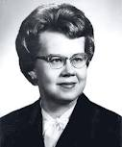
Dorothy Johnson
Behavioral Systems Model

Slide 2
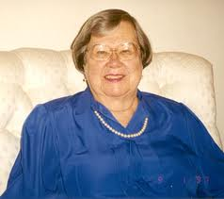
Personal Background
Born August 21st 1919 in Savannah, Georgia.
1938 – A.A. form Armstrong Junior College, Savannah, Georgia.
1942 – B.S.N. from Vanderbilt University, Nashville, Tennessee.
1948 – M.P.H. from Harvard University, Boston, Mass. Massachusetts.
Death in February 1999 at the age of 80.

Slide 3
Professional Background
Assistant professor of pediatrics at Vanderbilt University.
Assistant professor of pediatrics nursing, an associate professor of nursing, and a professor of nursing at the University of California.
Pediatric nursing advisor for the Christian Medical School of Nursing in Vellore, South India.
Chairperson on the California’s Nurses Association that developed a position statement for specifications for clinical specialists.
Publications include four books, more than 30 articles, and many other papers, reports, proceedings and monographs.

Slide 4
Theoretical Background
Influenced heavily by Florence Nightingale’s book, Notes on Nursing.
Used the work of behavioral scientist, psychology, sociology, and ethnology to form her seven subsystems.
Also relied on the system theory and used concepts and definitions from Rapport, Chin, von Bertalanffy, and Buckley.
(Alligood & Tomey, 2010)

Slide 5
Description of the Theory
Conceptualizes a person as a behavioral system, in which the behavior of the person as a whole is the focus.
The behavioral system is divided up into seven subsystems that are open, linked, and interrelated. Balance is maintained within an individual’s subsystems.
These seven subsystems are continuously changing through maturation, experience, and learning.
The nurses goal is to help the patient obtain and maintain equilibrium, in which the person is in harmony with themselves and the environment.
(Alligood & Tomey, 2010)

Slide 6
Main Concepts
The “Human being” as having two major systems, the biological system which is the focus of medicine; and the behavioral system which is the focus of nursing.
“Society” relates to the environment in which an individual exists, where the environment has influence on the individual’s behavior.
“Health” is a purposeful adaptive response to internal and external stimuli in order to maintain stability and comfort.
“Nursing” has a primarily goal to foster equilibrium within the individual and maintaining balance in the Behavior system in the state of illness.
(Nursing Theories, 2011)

Slide 7
Other Concepts
Behavior
System
Behavioral System
Subsystems
Attachment - Affiliative
Dependency
Ingestive
Eliminative
Sexual
Achievement
Aggressive - Protective
Equilibrium
Functional Requirements / Sustenal Imperatives
Regulation / Control
Tension
Stressor
(Alligood & Tomey, 2010)

Slide 8
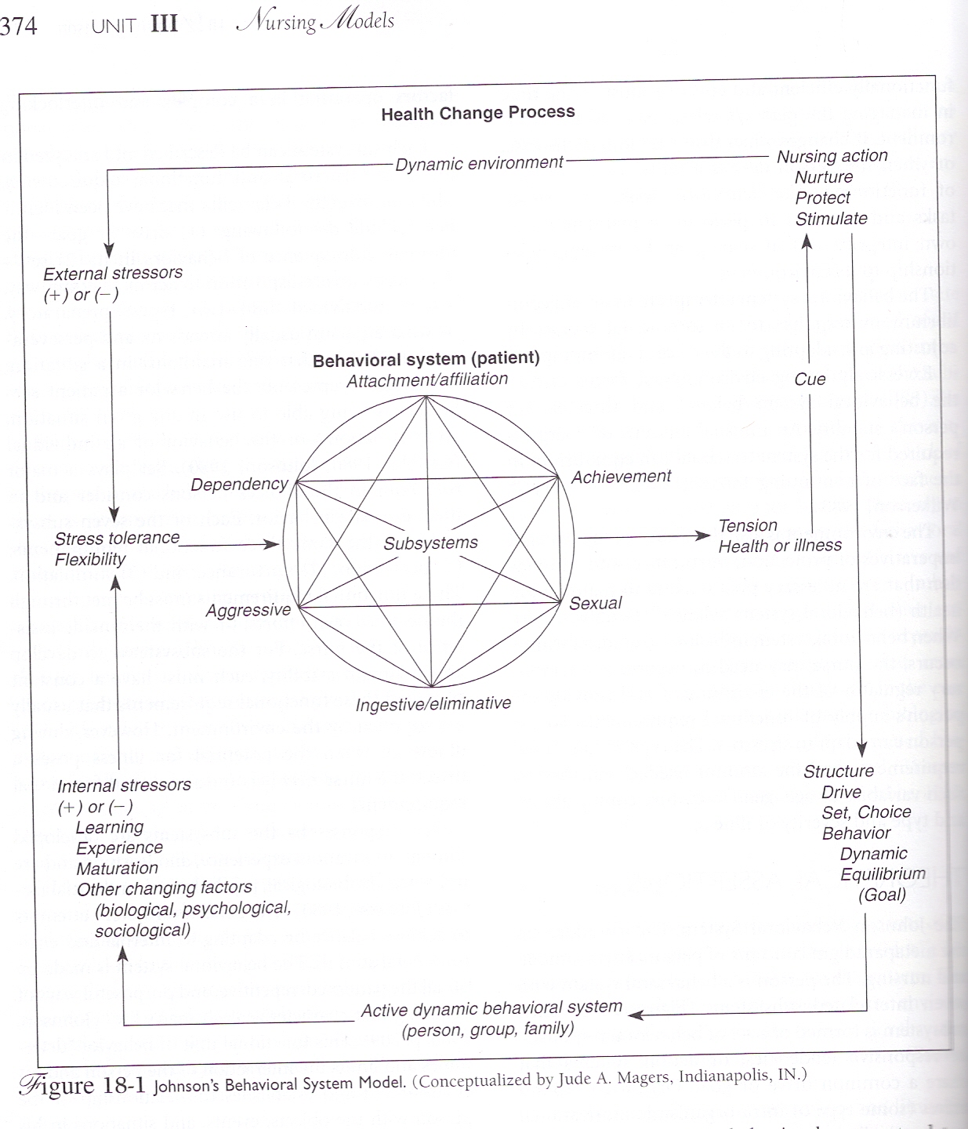

Slide 9
Relationships to the Metaparadigm
Nursing: is seen as an external force -the goal is to maintain and restore an individuals behavioral systems balance through imposing temporary regulatory or control mechanisms through resources.
Person: is a behavioral system with patterned, repetitive, and purposeful, ways of behaving that link to person to the environment.
Health: a lack of balance in the structure or functional requirements of the subsystems lead to poor health.
Environment: are all factors that are not part of a person’s behavioral system but has influence of the behavioral system.

Slide 10
Internal Analysis

Slide 11
Definitions
Some of the concept definitions are used from other theories or areas, for example she used the behavioral and biological scientists definition for behavior.
All the definitions are well defined and are appropriate to the theory.

Slide 12
Importance
In the Johnson’s Behavioral Systems Model the seven subsystems is where an individual maintains their balance. Each subsystem is as import as the other.
However the focus is on the behavior as a whole and not within each subsystem.
The other concepts are also equal in importance as they can have influence on behavior.

Slide 13
Assumptions
Johnson makes multiple assumptions in three main areas.
System
Subsystem
Functional requirements

Slide 14
Relationships
The seven subsystems make up the behavioral system of the patient.
Internal and external stimuli or stressors influence a persons behavior.
Nurses, family, and everything outside of the person’s behavioral system is the environment.
An imbalance of structure or functional requirements of the behavioral system creates poor health conditions.

Slide 16
External Analysis

Slide 17
Semantic Clarity and Consistency
Definitions and concepts are used and derived from other theorists and other fields.
Some of the concepts are abstract and difficult to use.
The concepts and definitions are used consistently. Johnson’s first released her first model in 1968 and then conceptualized it for nursing in 1980, where she explained her definitions for the model.
Notes:
The first of which is observation, but the second includes action.

Slide 18
Structural Clarity and Consistency
The structure has been diagramed.
The relationships have been clearly stated.
Within the construct of the Model shown in slide 11, the flow of the theory is clear.
Notes:
When first observing the Model it appears confusing however following the arrows leads ones eye quickly on the correct path.

Slide 19
Simplicity
Although the structure of Dorothy Johnson’s Theory is clear, it is anything but simple.
The thought process that goes into her theory is complex with many factors that effect each other.
Both external and internal influences effect each client in different ways
Notes:
In Dorothy Johnson’s theory “cue tensions” observed signal disequilibrium.

Slide 20
Generalizability
Johnson’s Behavioral Systems Model is applicable to all human beings from infancy to the elderly.
The theory has been applied in many different clinical settings.
The Behavioral Systems Theory has been used by many and has been demonstrated to be useful in clinical practice.
Notes:
Johnson uses terms such as balance, stability, equilibrium, adjustments and adaptations

Slide 21
Accessibility
“Johnson’s theory is comprehensive and broad enough in scope to include all areas of nursing practice”
All areas of nursing can access and apply the Behavioral Systems Model
Notes:
In nursing school we are taught to view the patient as a whole, including their external influences

Slide 22
To Clinical Practice
“Both deductive and inductive systems thinking is evident” within the Behavioral System Theory
The “system” as a whole works well , however when broken down, looses it’s synergistic effect
Understanding of the Theory must progress from the bigger picture, or “whole”, to the individual parts.
“Johnson also believed that groups of individuals, such as families and communities, could be considered groups of interactive behavioral systems”.
(Alligood & Tomey, 2010)
Notes:
Each system and subsystem need each other to make this theory function as Ms Johnson intended.

Slide 23
To Education
This theory lends itself well to research and education
The human being is observed as a whole considering external influences, and studied within the subsystems
The nursing process linked with theoretical models are commonly used to address all areas of human ailments from obesity to diabetes
“one of the strengths of the Johnson’s Behavioral System Theory is the consistent integration of concepts defining behavioral systems drawn from general system theory”
(Alligood & Tomey, 2010)
Notes:
Making Johnson's theory relevant to not only nursing education she used the work of behavioral scientists in psychology, sociology and ethnology to develop her theory. Including holism, goal seeking, interrelationship/interdependancy, energy feedback, and adaptation.

Slide 24
To Administration
To implement Dorothy Johnson’s theory, the cooperation of staff is key.
Social workers will be needed to address environmental issues and also address economic issues that effect medication compliance
This theory has been used for administration as a framework when making decisions concerning the management of impaired nurses.
(Alligood & Tomey, 2010)
Notes:
“Nurse Ratchet” will only hinder the healing process no support it. Many disciplines are needed to have success in pt care.

Slide 25
Video
Dorothy Johnson

Slide 26
Discussion
What is the relevance of Dorothy Johnson’s Behavior System Model to your own area of nursing?
How can Johnson’s theory be applied during an in-hospital stay?
Are we as professionals compassionate to those who have instability in one or more of Johnson’s subsystems causing dysfunction?

Slide 27
Bibliography
http://currentnursing.com/nursing_theory/behavioural_system_model.html
Marilyn Parker, Nursing theories in practice, chapter four.
Reference list in Alligood and Tomey.

Slide 28
References
Holiday, B. (2010). Dorothy Johnson: Behavioral systems model. In M. Alligood, & A. Tomey (Eds.), Nursing theorists and their work (pp.366-390).
Current Nursing (2011). Nursing theories: Johnson’s behaviour system model. Retrieved from http://currentnursing.com/nursing_theory/behavioural_system_mo del.html

