Slide 1
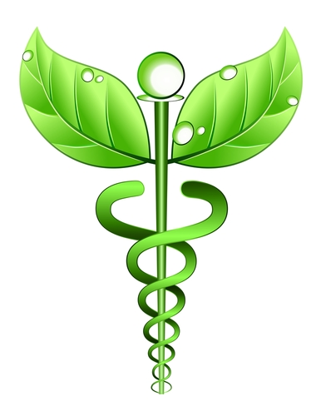
Complementary and Alternative Medicine (CAM) in the Critical Care Arena
by
Jessica Gutsjo, RN BSN,
Shawn Kise, RN bsn, &
Whitney Dunbar, RN BSN

Slide 2
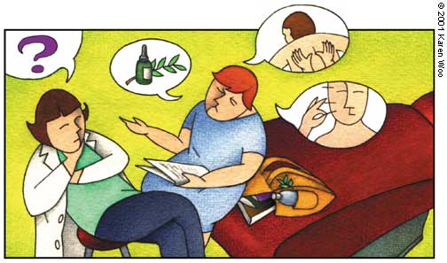
Objectives
Review the foundation of complementary and alternative therapies
Discuss the different types of complementary and alternative therapies
Describe the current research and emerging complementary and alternative therapies in critical care setting

Slide 3
Outline of Topics
Definition of CAM and specific types of CAM
Recommendations by the FDA
Disclaimer
Mind-body therapies
Energy therapies
Manipulative & body-based therapies
Biological-based therapies
Conclusion
Discuss article
Multiple choice questions (5)
References

Slide 4

FOUNDATIONS FOR PRACTICE

Slide 5
DEFINITION REVIEW
“Complementary” generally refers to using a non-mainstream approach together with conventional medicine.
“Alternative” refers to using a non-mainstream approach in place of conventional medicine.
“Integrative medicine” the use of both conventional and non-mainstream treatments that have evidence of safety and effectiveness
Notes:
National center for CAM

Slide 6

Integrative medicine example
Cancer treatment centers with integrative health care programs may offer services such as acupuncture and meditation to help manage symptoms and side effects for patients who are receiving conventional cancer treatments such as chemotherapy.

Slide 7

National Center for Complementary and Alternative Medicine (NCCAM)
NCCAM’s Role
NCCAM is the Federal Government’s lead agency for scientific research on health interventions, practices, products, and disciplines that originate from outside mainstream medicine.

Slide 8
NCCAM’s Mission and Vision
The mission of NCCAM is to define, through rigorous scientific investigation, the usefulness and safety of complementary health approaches and their roles in improving health care.
NCCAM’s vision is that scientific evidence will inform decision making by the public, by health care professionals, and by health policymakers regarding use and integration of complementary health approaches.

Slide 9
Disclaimer
  "Rigorous, well-designed clinical trials for many CAM
  therapies are often lacking; therefore, the safety and effectiveness of many CAM therapies are uncertain. Be aware that some dietary supplements may interact with medications or other supplements, may have side effects of
  their own, or may contain potentially harmful ingredients not listed on the label. Also keep in mind that most supplements have not been tested in pregnant women, nursing mothers, or children. Tell all your health care providers about any complementary and alternative practices you use. Give
  them a full picture of what you do to manage your health. This will help ensure coordinated and safe care." -NCCAM

Slide 10
PATIENT EDUCATION
Before trying alternative therapies patient should consult a medical professional, especially when trying new herbal or complementary medicines.
Beware of fraudulent products.

Slide 11
Considerations
It is important to review the patients insurance/income status before recommending or prescribing an alternative therapy.
In 2007, adults in the United States spent $33.9 billion out of pocket on visits to CAM practitioners and purchases of CAM products, classes, and materials.
Notes:
National health statistics report 2009

Slide 12
COST EFFECTIVENESS
In January 1996, the state of Washington enacted legislation mandating coverage for services provided by all of the state’s licensed categories of health care providers.
The law includes acupuncturists, doctors of Asian medicine, medical doctors, chiropractors, naturopathic physicians, registered nurses, podiatrists, and massage therapists.

Slide 13
COST EFFECTIVENESS
Recently, an analysis of the Washington State experience supported by the National Institutes of Health was conducted.
The results suggested that expected overall medical expenses would be $9.4 million lower for a group of 26,466 CAM users with the medical conditions that were reviewed compared to an equal size group of similar nonusers.
Notes:
It was noted in the introduction to the comparison that because CAM therapies “avoid high technology” and “offer inexpensive remedies” they may offer cost savings.

Slide 14
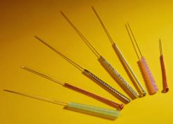


THERAPIES
Acupressure/Acupuncture
Earthing/Grounding
Tai Chi
Aromatherapy
Bee venom therapy

Slide 15
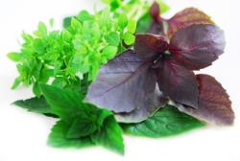
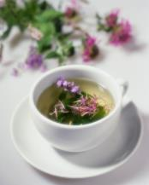
HERBAL MEDICATIONS
Feverfew
Vitamin D
Folic Acid
Soy
Cranberry
Garlic
Red yeast rice
Plant sterols
Gingko
Saw Palmetto
Echinacea
Black Cohosh
Milk thistle
Ginseng
St. John’s wort
Valerian
Selenium
Coenzyme Q10
Glucosamine/Chondroitin
SAMe

Slide 16
Mind-Body Therapies
Definition of Mind-Body Therapy
Short overview of research
Examples: Imagery, Music Intervention, Humor, Yoga, Biofeedback, Meditation, Prayer, Storytelling, Journaling, Animal-Assisted Therapy
“To keep the body in good health is a duty… otherwise we shall not be able to keep our mind strong and clear.” -Buddha
Notes:
-Mind-Body Therapies encompass those that promote the mind’s capacity to have an impact on the functioning of the body
-Emerging body of research… from Herbert Benson’s work in the 1960s on the effect of transcendental meditation on blood pressure to the increasing number of psychoneuroimmunological studies, the interconnectedness of the mind and body is being documented
-Measurement of several outcomes, such as, physiological, psychological, and spiritual, is needed in which complementary therapies are tested. However, these studies have challenges for identifying and measuring outcomes

Slide 17

Presence
Overview
Application for ACNPs
Research: Impact of nursing presence in a outpatient clinic with heart failure patients
Notes:
Presence is the physical being there and the psychological being with a patient for the purpose of meeting the patient’s health care need/ also being present for family
Nurse needs to genuinely engage with the patient to have true presence
Entails RN to show readiness, a readiness, or an availability
Even if patient and RN cannot communicate verbally, the patient can perceive the presence of a caring nurse (Give example of pt on vent who may be able to write on a white board or a pt that is trach and quadriplegic)
Nursing presence is the foundation of a long-term nurse-patient relationship that improves clinical decision making and ultimately patient outcomes. A home-based, advanced practice nurse-directed program uses presence at the heart of service delivery in an outpatient heart failure program that addresses complex healthcare needs of this patient population
-Research article: Establishing presence involved prerequisites which was self-awareness, openness, flexibility, and a willingness to embrace another person’s situation. Nurse-patient relationship builds and continuity of care is a way to demonstrate presence for patients living with an advanced illness
-The impact of presence on patient outcomes such as adherence, quality of life, and patient satisfaction is unknown d/t no tool to measure presence… how do u teach presence to new nurses
-Evidence displayed a decrease in unplanned hospitalizations and associated costs for elderly with heart failure ‘
-Other studies have reported presence making patients feel safe, decrease stress, enhanced coping strategies, and mental well-being
- Telehealth and remote monitoring patients… do the nurse and the patient have to be in close physical proximity for presence to unfold?

Slide 18
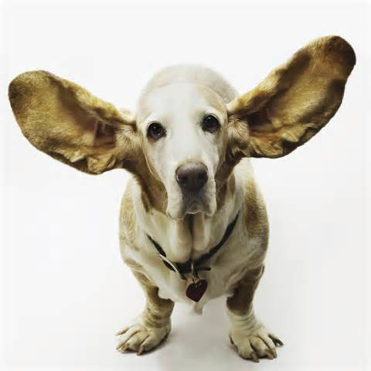
Therapeutic Listening
Overview
Application to ACNP
Research example: Discussing code status with family
“The most basic of all human needs is the need to understand and be understood. The best way to understand people is to listen to them.” –Ralph Nichols
Notes:
An interpersonal confirmation process involving all the senses in which the therapist attends with empathy to the client’s verbal and nonverbal messages to facilitate the understanding, synthesis, and interpretation of the client’s situation
3 key components to show patient you are actively listening 1) rephrasing the patient’s words and thoughts to ensure clarity and accuracy 2) conveying an understanding of the speaker’s perceptions 3) asking questions and prompting in order to clarify
Ie: Important when interviewing patient and getting history, a lot of what patient says can give you the diagnosis
Communication skills, such as, therapeutic listening, are key for quality-end-of-life care including in the critical care setting
Communication processes that have been shown to improve the well-being of patients and family members include proactive, multidisciplinary sessions that provide patients (when they are able to communicate) and family members with the opportunity to ask questions, articulate the patient's values, express painful emotions, discuss concerns, and obtain help with managing feelings of guilt
A study with family members of 126 patients dying in 22 ICUs were randomly assigned to an intervention format where it involved more therapeutic listening or a typical end of life conference. Lautrette and colleagues found by having formal bereavement meetings with family and critical care healthcare provider where death was inevitable for the patient, it improved the well being of the family. It demonstrated statistical and clinical significant improvement in symptoms of anxiety (45% vs 67%, P=0.02), depression (29% vs 56%, P=0.003), and PTSD among family members (45% vs 69%, P=0.01), and it shows that expanding the focus of critical care to include family-centered outcomes is appropriate and desirable.
Suggests that spending an average of 30 minutes (or 10 minutes longer than typical practice)

Slide 19

Imagery
Overview
Goal
Application for ACNPs
Research- Manage pain in elderly orthopaedic population & cardiac
Notes:
Formation of a mental representation of an object, a place, an event, or a situation that is perceived through the senses
-Thought to modify disease & reduce symptoms by lowering the stress response that is mediated by psychoneuroimmune interactions (goal is to reframe stressful situations from negative responses of fear and anxiety to positive images of healing and well-being)
-Used to relieve chronic, procedural pain, insomnia, prevent allergic responses, and lower high blood pressure
-Purpose of study was to tests effects of GI intervention in pts who had joint replacement surgery. Pilot study of two-group experimental repeated measures design where one group received usual therapy plus guided therapy
-Results indicated positive outcomes in pain relief (control group mean of 84.76mg of morphine and intervention group had 36.7mg in 4 postoperative days & pt report on pain scale was 5.3 compared to 2.35 , decreased anxiety, and decreased length in stay 14.83 vs 9.29 (need larger sample)
-Laboratory studies and clinical trials have demonstrated that GI are effective in reducing stress, restructuring behaviors, reducing heart rate reactivity, blood pressure, and resting heart rate

Slide 20


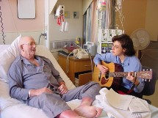
Music
Overview
Application to ACNP
Research: Cardiovascular and critical patients
Notes:
-The art of arranging sounds in time so as to provide a continuous, unified and evocative composition, as through melody, harmony, rhythm, and timbre
-Get patients preference, ask family if vented
-IE: patient weaning from vent and reducing sedation medication
-Rhythm and tempo of music can be used to synchronize or entrain body rhythms, such as, HR, R pattern, with resultant changes in physiological states
-Less than 80 beats per minute with fluid, regular rhythm can be used to promote relaxation
-Use at appropriate times… don’t have Lady GaGa on when your patients heart rate is in 150s tachying away or if stroke and high ICPs or procedures
-Studies focus on using music to reduce stress and anxiety in cardiovascular and critically patients
-In a randomized controlled trial, a sample of 80 patients with a presumptive dx of acute MI in a critical care unit were assessed to see if music therapy was effective in reducing stress, Music therapy group received 3 sessions for 2 days and results found that the patients who received music therapy had fewer physiologic indicators of stress & lower incidence of cardiac complications then the control group
-Review of 7 clinical trial, 375 ventilated patients, studies displayed a decrease in HR, BP, RR, and state trait anxiety index but no significant change in ventilator days

Slide 21

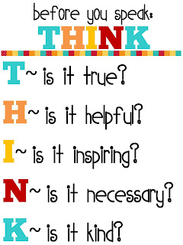
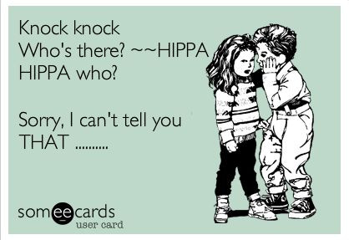
Mind-Body Therapies cont.
Humor
  What is it?
  Why is it important?
  How can it be used?
  Are there any precautions in using humor?
  Examples
Notes:
What is humor? An form of communication that leads to laughter, smiling, or feeling of amusement
Why is it important? Humor and laughter can improve one’s ability to cope with difficulties. Enhance the well-being of the patient, enhance the relationship between the nurse and the patient, and to bring hope and joy to the situation – including their loved ones. Outlet for stress for patient and nurses.
How can it be used? Can be used as monotherapy or with other therapies.
Are there any precautions in using humor? The timing of the use of humor in the clinical setting is crucial to its success.
Example of humor: showing a patient a funny picture, telling them a joke, showing the patient a funny video clip

Slide 22
Mind-Body Therapies cont.
Biofeedback
  What is it?
    In English, please!
    Example
  What does the research say about biofeedback?
Notes:
What is it? The use of electronic monitoring of an automatic bodily function to train someone to acquire voluntary control of that function.
In English: Biofeedback is when one connects the power of their mind and becomes aware of what is going on inside their body to gain more control over their health. For example, a relaxation tape helps the patient relax their muscles to reduce their blood pressure while the EMG biofeedback instrument informs the nurse of the progress.
What does the research say about biofeedback? There are a few benefits in the use of biofeedback for HTN control, but there was no convincing evidence that consistently demonstrated the effectiveness of the use of any particular biofeedback treatment in the control of essential hypertension when compared with pharmacotherapy, placebo, no intervention or other behavioral therapies.

Slide 23

Mind-Body Therapies cont.
Meditation
  What is it?
  When is meditation typically used?
  Different approaches to meditation
  As the ACNP, how do I know that meditation is useful?
Notes:
What is meditation? Depends on where you look! Western literature defines meditation as an exercise in which the individual focuses attention or their awareness to dwell on a single object. Meditation is also defined as a technique that allows individuals to investigate the process of their consciousness and experiences and to discover the more basic underlying qualities of their existence as an animate reality. The intense concentration utilized for meditation blocks other stimuli, allowing the person to become more aware of self.
When is meditation typically used? Stress reduction, anxiety, and anxiety-related disorders, insomnia, and overall improvement in well-being. In addition, asthma, cancer, pain, depression, headache, HIV/AIDS (a study in 2003 found natural killer cell activity and number of these cells to be increased significantly).
Mindfulness meditation: The goal of mindfulness meditation is to increase insight by becoming a detached observer of the stream of changing thoughts, feelings, drives, and visions until their nature and origin are recognized. The focus is on the relaxation response, center on breathing, and attention moves freely from each perception to the next.
Transcendental meditation: The person takes a word or a sound and repeats it silently over and over again while sitting in a comfortable position. Most commonly used method of meditation.
Evidence of efficacy can be seen by a reduction blood pressure readings, heart rate, respiratory rate. True efficacy would be evidenced through a reduction in these values over time. Research states to check blood pressure before starting meditation and meditation is not advised with a blood pressure less than 90 systolic. Meditation should be avoided in patients who are lightheaded or are dizzy. Hypotension commonly occurs after meditation so quick position changes should be avoided.

Slide 24


Mind-Body Therapies cont.
Prayer/Spirituality
  What is it?
  Existence of a higher being
  Holistic
  Cultural diversity
  What does the research say about prayer/spirituality?
Notes:
There are many definitions to define prayer. From Latin, the term means to obtain by begging. Prayer is also defined as communicating with a higher being. Another definition is the lifting up of the heart and soul to a higher being.
Existence of a higher being: Prayer does not necessarily have to be equated to religion even though it commonly is. Prayer and spirituality acknowledge the existence of a Greater or Higher Being and humans have connections to this higher being.
The idea of prayer and spirituality has been apart of nursing practice for centuries and is a part of the holistic aspect of nursing. Since America is becoming such a huge melting pot; it has become increasingly important for nurses and other medical professionals to become more culturally aware.
What does the research say about prayer/spirituality? Spiritual practices such as prayer generate positive emotions resulting in a reduction in ones level of stress, depression, self-esteem, or mood. A specific study example of a positive outcome with prayer/ spirituality is: A study found that patients who prayed following cardiac surgery had a significant decline in depression at one year compared to immediately after surgery. Other studies concluded that people who went to church regularly also were more likely to engage in health-promoting behaviors such as exercising and not smoking.

Slide 25
JOURNALING
One of the ways to deal with any overwhelming emotion is to find a healthy outlet in which to express yourself.
Journaling can help:
  Manage anxiety
  Reduce stress
  Cope with depression
Journaling helps control your symptoms and improve your mood by:
  Helping your prioritize problems, fears, and concerns
  Tracking any symptoms day-to-day so that you can recognize triggers and learn ways to better control them
  Providing an opportunity for positive self-talk and identifying negative thoughts and behaviors

Slide 26
REMINISCENCE THERAPY/
STORYTELLING
This type of therapy is an effective treatment for:
• Memory loss
• Dementia
• Depression
• Anxiety
Notes:
Finding meaning in memories. Lets patients know their still a person.

Slide 27
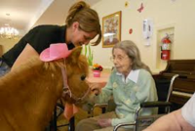
ANIMAL ASSISTED THERAPY
Benefits
Conditions/disorders
Improved fine motor skills
Improved balance
Increased focus and attention
Increased self-esteem and ability to care for oneself
Reduced anxiety, grief and isolation
Reduced blood pressure, depression, and risk of heart attack or stroke
Improved willingness to be involved in a therapeutic program or group activity
Increased trust, empathy and teamwork
Greater self-control
Enhanced problem-solving skills
Reduced need for medication
Improved social skills
Autism spectrum disorders
Addiction
Cancer
Heart disease
Dementia
Developmental disorders
Psychiatric disorders such as schizophrenia
Emotional and behavioral disorders
Chronic pain

Slide 28
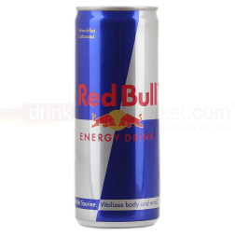

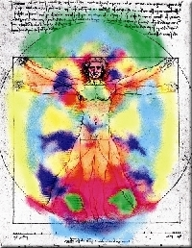
Energy Therapy
What it is
Examples:
  Magnet Therapy
  Healing Touch
  Therapeutic Touch
  Reiki
  Acupuncture
  Reflexology
Notes:
Focus on energy originating in or near the body and energy coming from other sources
Most cultures have a word for energy such as Qi in China

Slide 29
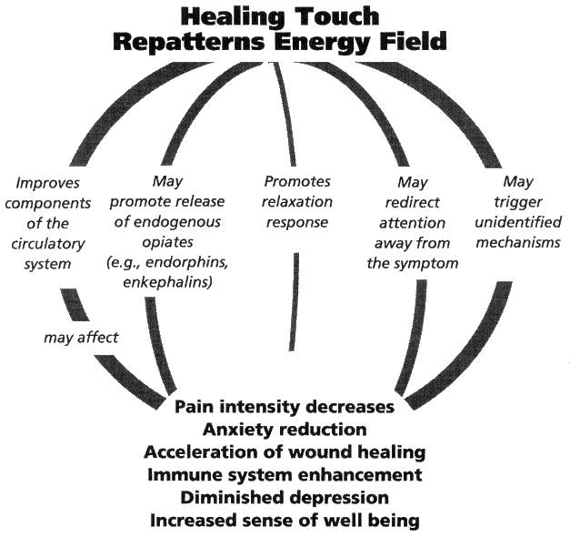
Healing Touch
What it is
Holistic
Culture differences
Research & Application: Model for the acute care setting & CABG recovery patients
Notes:
Uses gentle energy-based techniques to influence and support the human energy system within the body (energy centers) and surrounding the body (energy fields)
Focuses on creating an energetic balance of the whole body rather than on a dysfunctional part; it opens energy blockages and creates an environment that is conducive for self-healing
-Cultural differences- Eastern: based on energy channels (meridians), energy fields (auras), & energy centers (chakras) & professionals use hands to influence flow of energy to promote balance & healing; Western focuses on energy to physiological changes that occur at the cellular level from touch therapies that are believed to influence healing; now blending the two has led to different touch therapies and one of them being healing touch
Model is from an article of applying healing touch in the acute care setting; example one study found a high abundance of large amplitude alpha brain activity through an EEG in the subjects receiving healing touch with eyes opened and closed. This demonstrated a state of deep relaxation
HT in CABG recovery patient: 237 study subjects from an acute-care hospital in a large city randomised into 1 of 3 groups (HT, control, visitor). Results showed no significant decrease in use of pain medication, anti-emetic meds, incidence in afib. Significant decrease in anxiety scores (P=0.04) and length of stay 5.8 (80%) compared to 6.5 ( 62%) & 6.0 (70%) in subjects who received HT

Slide 30
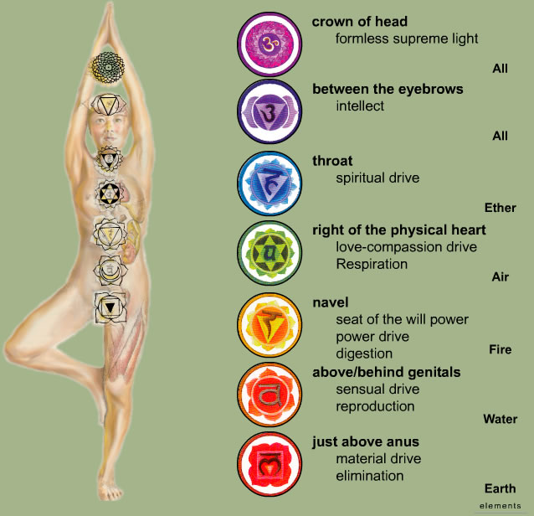
Reiki
What it is
Research and Application:
  Acute Coronary Syndrome
  Type II Diabetes Mellitus
Notes:
- From two Japanese words: Rei (universal) and Ki (life force energy that flows throughout all living things)
-Spiritual guided life force energy or universal life force energy- when Ki energy is unrestricted, there is thought to be less susceptibility to illness or imbalances of mind, body, or spirit
-Emphasis on healing, not cure -Also thought to reduce inflammation, relieve pain and stress
-Person needs to become attuned to the energy to use it
-Refers to the healing system and to the process of accessing the energy
-A randomised, semidouble-blind, placebo-controlled study assessed Reiki therapy to alleviate pain and improve mobility and quality of life in 207 subjects with type 2 DM and painful diabetic neuropathy. Compared with baseline, the total score for pain descriptors improved greatly (P=<0.05 in the Reiki group over the control group but the final pain scores were not significantly different btw groups
- In the Epidemiology of Diabetes Intervention and Complications questionnaire displayed minor improvement with Reiki group (P=0.05)
-A randomised study of 37 inpatients at a hospital recovering from ACS received either Reiki, classical music intervention, or resting control while undergoing continuous EEG monitoring. Reiki tx increased positive emotional states from baseline compared to other two groups (p=<0.05). Increased high freqeuncy heart rate variability increased from baseline (p=0.02) and displayed a significant increase in vagal activity. No change in control group and decreased in music group. Findings suggest a potential clinical role for Reiki in post-ACS inpt setting but should research if tx over a longer period of time can generate lasting benefits for autonomic balance and psychological well-being

Slide 31
Manipulative and Body-Based Therapies
Therapies involving the manipulation and movement of body parts
  Chiropractic
  Osteopathy
  Massage
  Reflexology
  Acupuncture
  Acupressure

Slide 32
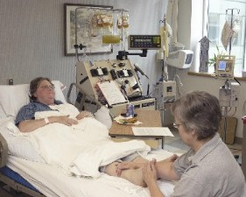
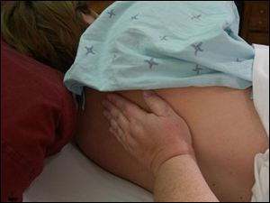
Manipulative and Body-Based Therapies cont.
Massage
  What is it?
  Commonly utilized
  Commonly used in combination with other therapies
  What are the benefits?
  Precautions
Notes:
The term massage comes from the Arabic and means to press gently.
Most common form of Manipulative and Body-Based Therapies but frequency of use has decreased due to nurses being “too busy”. Some institutions have massage therapists on staff with patients paying for these services. Massage is often combined with other therapies such as music, aromatherapy, acupressure, and simple touch, so it is difficult to differentiate the specific effects of massage from those resulting from a combination of therapies.
The benefits to massage is the production of relaxation, improvement in sleep, and reduction in pain. Massage has been shown to decrease blood pressure, heart rate, and skin temperature.
Some people may be against massage due to previous negative experiences. Other people may be hypersensitive to touch. Massage is appropriate for the patient with moderate to severe dementia of the Alzheimer’s type to decrease anxiety and emotional distress and increase relaxation.

Slide 33
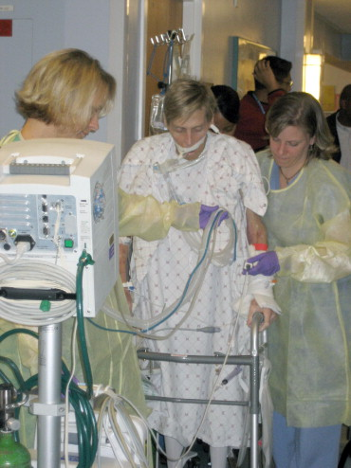
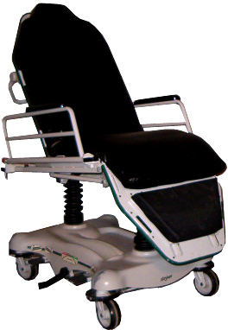
Manipulative and Body-Based Therapies cont.
Exercise
  Definition
  Benefits
  Examples of exercise in the critical care arena
  Recommendations for patients
Notes:
Exercise is defined as any bodily movement produced by skeletal muscles that results in caloric expenditure. There are many other definitions depending upon the discipline.
There are many benefits to exercise. Mortality and morbidity are reduced in physically fit individuals compared with sedentary individuals. The effects of exercise have been linked to many positive physiological and psychological responses, including a reduction in stress and an increased sense of well-being. There are multiple risks associated with being sedentary, including: coronary heart disease, diabetes, colon cancer, hip fractures, hypertension, and obesity.
Examples of exercise in the CC arena: OT/PT, stretcher chair
Recommendations for patients: the CDC and the American College of Sports Medicine (ACSM) recommend that individuals should engage in 30 minutes or more of moderate-intensity physical activity on most (preferably all) days of the week

Slide 34
Manipulative and Body-Based Therapies cont.
Progressive Muscle Relaxation
  What is it?
  Involved in many other complementary therapies in nursing
  What does the research say?
  When is it typically used?
Notes:
Progressive Muscle Relaxation is defined as bringing awareness to the muscle in the body and the tension that exists in them, and reducing this tension. Awareness can be achieved either by tensing the muscles even more and then releasing the tension or by focusing attention on the muscles and imaging them being free of tension.
Involved in many other complementary therapies in nursing; such as, guided imagery, yoga, breathing exercises, decreasing anxiety, and promoting comfort.
What does the research say? Progressive muscle relaxation decreases the body’s oxygen consumption, metabolic rate, respiratory rate, muscle tension, PVC’s, blood pressure, and alpha brain waves.
When is it typically used? Stress reduction, pain reduction, health promotion, insomnia, HTN, cardiac rehab.

Slide 35
BIOLOGICAL-BASED THERAPIES
These treatments use ingredients found in nature.
Examples of herbs include ginseng, ginkgo and Echinacea, while examples of other dietary supplements include selenium, glucosamine sulfate and SAMe.
Herbs and supplements can be taken as teas, oils, syrups, powders, tablets or capsules.

Slide 36
BIOLOGICAL-BASED THERAPIES
CoQ10
Though to help with heart failure, cancer, muscular dystrophy, and periodontal disease.
CoQ10 Promising for Chronic Heart Failure
Reactive oxygen species, oxidative stress, and cell death correlate with level of CoQ10 deficiency (Quinzii et al., 2010)
Notes:
a supplement containing the antioxidant coenzyme Q10 (CoQ10) improved outcomes in patients with moderate-to-severe chronic heart failure, a small placebo-controlled trial showed.
2. No difference at 3 months but at 2 years, the patients who received the supplement had a significantly lower rate of major adverse cardiovascular events than those who did not take CoQ10 .
3. Both all-cause and cardiovascular mortality were significantly reduced in the supplement group
4. 30–50% residual CoQ10 is accompanied by increased ROS production and cell death. Our results confirm that varying degrees of CoQ10 deficiency
cause variable defects of ATP synthesis and oxidative stress. These findings may lead to more rational therapeutic strategies for CoQ10 deficiency

Slide 37
BIOLOGICAL-BASED THERAPIES
HAWTHORN
Hawthorn extract for treating chronic heart failure (Guo, Pittler, & Ernst, 2009)
Maximal workload, exercise tolerance, pressure-heart rate product, shortness of breath and fatigue were all improved in the hawthorn treatment group as compared to placebo.
No data on relevant mortality and morbidity such as cardiac events were reported, apart from one trial, which reported deaths (three in active, one in control).
Notes:
Meta-analysis used ten trials including 855 patients with chronic heart failure (New York Heart Association classes I to III)

Slide 38
BIOLOGICAL-BASED THERAPIES
Black and Green Tea
Black and green tea consumption and the risk of coronary artery disease (Wang et al., 2011)
  Black tea showed no protective role.
  Green tea showed a tentative association with reduced risk of CAD.
Notes:
1. A total of 18 studies were included in the meta-analysis: 13 studies on black tea and 5 studies on green tea
2. Our data do not support a protective role of black tea against CAD. The limited data available on green tea support a tentative
association of green tea consumption with a reduced risk of CAD. However, additional studies are needed to make a convincing
case for this association.

Slide 39
Conclusion
Foundation of CAM- Complementary, Alternative, & Integrative Medicine
Different types of therapies of CAM used for certain disease states, in the acute care setting, & prevention
Need further research
  Difficult with identifying and having measuring outcomes
Notes:
Important as ACNPs we understand the use of CAM, know the interactions btw the non-mainstream therapies and conventional therapy, when we can implement or suggest CAM to a patient or family
-Could implement when a patient is feeling anxiety, stress, pain

Slide 40
Review of Questions and Article
1.) What are the five major domains of CAM that the NCCAM identified?
2.) If your employer wanted to integrate biomedical and complementary therapies into a developing cardiovascular program, what kinds of therapy would you suggest and why?

Slide 41
Review of Questions and Article cont.
3.) You are assessing a patient to determine if CAM would be appropriate as part of the treatment plan. Which of the following factors should be assessed when making this determination?
  A. Medications, herbs, or other nutraceuticals the client is currently taking
  B. History of cardiac disease
  C. Patient’s interest in utilizing CAM
  D. Patient’s level of education
Notes:
A, B, C
A & C are obvious but B: Many CAM techniques lower blood pressure and decrease heart rate. Clients with a history of cardiac disease may be at an increased risk for cardiac arrhythmias and would need to be monitored closely for possible complications.

Slide 42
Review of Questions and Article cont.
4.)Which of the following CAM techniques would be appropriate for the patient with moderate to severe dementia of the Alzheimer’s type?
  A. Guided imagery
  B. Massage
  C. Breathing and relaxation techniques
  D. Biofeedback
Notes:
B: Massage. This technique is performed by the caregiver and can result in decreased anxiety and emotional distress and increased relaxation for the client with DAT at any stage.

Slide 43
Review of Questions and Article cont.
5.) CoQ10 has shown to improve all cause mortality in what patients?
  A. Renal failure
  B. Health care acquired pneumonia
  C. Cystic Fibrosis
  D. Heart failure

Slide 44
References
Antall, G. & Kresevic, D. (2004). The use of guided imagery to manage pain in an elderly orthopaedic population. Orthopaedic Nursing, 23(5), 335-40. doi:10.1097/00006416-200409000-00012
Anderson, J. (2007). The impact of using nursing presence in a community heart failure program. The Journal of Cardiovascular Nursing, 22(2), 89-94; quiz 95-6; discussion 97-8.
Davis, T. & Jones, P. (2012). Music therapy: decreasing anxiety in the ventilated patient: a review of the literature. Dimensions of Critical Care Nursing, 31(3), 159-66. doi:10.1097/DCC.0b013e31824dffc6
Friedman, R., Burg, M., Miles, P., Lee, F., , & Lampert, R. (2010). Effects of Reiki on autonomic activity early after acute coronary syndrome.Journal of the American College of Cardiology, 56(12), 995-6. doi:10.1016/j.jacc.2010.03.082
Gillespie, E., Gillespie, B., , & Stevens, M. (2007). Painful diabetic neuropathy: impact of an alternative approach. Diabetes Care, 30(4), 999-1001. doi:10.2337/dc06-1475
Greenhalgh, J., Dickson, R., , & Dundar, Y. (2010). Biofeedback for hypertension: a systematic review. Journal of Hypertension, 28(4), 644-52. doi:10.1097/HJH.0b013e3283370e20
Kreitzer, M., & Snyder, M. (2002). Healing the heart: Integrating complementary therapies and healing practices into the care of cardiovascular patients. Progress in Cardiovascular Nursing, 73-80.
Lautrette, A., Darmon, M., Megarbane, B., Joly, L., Chevret, S., Adrie, C., ,…Azoulay, E. (2007). A communication strategy and brochure for relatives of patients dying in the ICU. New England journal of medicine, 356(5), 469-78. doi:10.1056/NEJMoa063446
MacIntyre, B., Hamilton, J., Fricke, T., Ma, W., Mehle, S., , & Michel, M. (2008). The efficacy of healing touch in coronary artery bypass surgery recovery: a randomized clinical trial. Alternative Therapies in Health & Medicine, 14(4), 24-32.
Snyder, M., & Lindquist, R. (2006). Complementary/alternative therapies in nursing. New York: Springer Pub. Co.
Thompson, P., Buchner, D., Pina, I., Balady, G., Williams, M., Marcus, B., ,…Wenger, N. (2003). Exercise and physical activity in the prevention and treatment of atherosclerotic cardiovascular disease: a statement from the Council on Clinical Cardiology (Subcommittee on Exercise, Rehabilitation, and Prevention) and the Council on Nutrition, Physical Activity, and Metabolism (Subcommittee on Physical Activity). Circulation, 107(24), 3109-16. doi:10.1161/01.CIR.0000075572.40158.77
Toms, R. (2011). Reiki therapy: a nursing intervention for critical care.Critical Care Nursing Quarterly, 34(3), 213-7. doi:10.1097/CNQ.0b013e31821c684d
Umbreit, A. (2000). Healing touch: applications in the acute care setting.AACN Clinical Issues: Advanced Practice in Acute & Critical Care, 11(1), 105-19. doi:10.1097/00044067-200002000-00012
Wardell, D. & Engebretson, J. (2001). Biological correlates of Reiki Touch(sm) healing. Journal of Advanced Nursing, 33(4), 439-45.

Slide 45
References
WebMD (2011). Coenzyme Q10 - Topic Overview.
Retrieved from http://www.webmd.com/heart-disease/heart-failure/tc/coenzyme-q10-topic-overview
Guo, R., Pitller, M. H., & Ernst, E. (2009). Hawthorn extract for treating chronic heart failure. The Cochrane Library, issue 1. DOI: 10.1002/14651858.CD005312.pub2.
The CHP Group. (2010). Complementary and Alternative Medicine: Integrating Evidence-Based and Cost-Effective CAM Into the Health Care System. Retrieved from http://www.chpgroup.com/images/Documents/WhitePapers/CHP_Group_CAM_White_Paper_2011-02.25.pdf
National Center for Alternative and Complimentary Medicine. (2013). Complementary, alternative, or integrative health: What’siIn a name? Retrieved from http://nccam.nih.gov/health/whatiscam
Nahin, R. L., Barnes, P. M., Stussman, B. S., & Bloom, B. (2009). Costs of complementary and alternative medicine (CAM) and frequency of visits to CAM practitioners: United States, 2007 . Retrieved from http://www.cdc.gov/nchs/data/nhsr/nhsr018.pdf
CRC Health Group. (2011). What is animal assisted therapy? Retrieved from http://www.crchealth.com/types-of-therapy/what-is-animal-assisted-therapy/
Dorset Health Care. (2009). What is reminiscence therapy? Retrieved from http://www.dorsethealthcare.nhs.uk/WS-Dorset-HealthCare/Downloads/Managing%20Your%20Health/Therapy%20Information%20Leaflets/L141-09ReminiscenceTherapy.pdf
Cole, K. M., Gawlinski, A., Steers, N., & Kotlerman, J. (2007), Animal-assisted therapy in patients hospitalized with heart failure. American Journal of Critical Care, 16. 575-585. Retrieved from http://ajcc.aacnjournals.org/content/16/6/575.full.pdf+html?sid=9618fa5f-b9db-4478-88a0-bdf4512775c9

