Slide 1
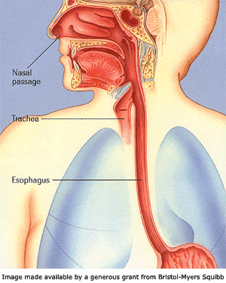
Esophagitis

Slide 2
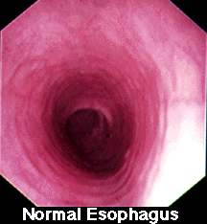
Esophagitis
This is the general term for any inflammation, irritation, or swelling of the esophagus.

Slide 3
Etiology of Esophagitis
Reflux esophagitis
Infectious esophagitis
Medicated – induced esophagitis
Eosinophilic esophagitis
Radiation/chemoradiation esophagitis

Slide 4
Epidemiology
Esophagitis is common in adults.
Most common type is associated with GERD.
Candida esophagitis is the most common type of infectious esophagitis.
The prevalence of symptomatic infectious esophagitis is high in individuals with AIDS, leukemia, and lymphoma.

Slide 5
Reflex Esophagitis
The gastric juices of reflex disease is harmful to the esophageal epithelium causing inflammation and irritation and may lead to more serious problems including erosive esophagitis and Barrett’s esophagus.

Slide 6
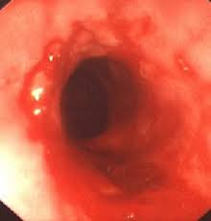
Endoscopy

Slide 7
Signs and Symptoms
Heartburn
Dyspepsia
Water brash
Upper abdominal discomfort
Nausea
Fullness
Dysphagia
Odynophagia
Cough
Hoarseness
Wheezing
Hematemesis
Chest pain

Slide 8
Differential Diagnosis
Infectious, pill, or eosinophilic esophagitis.
Peptic ulcer disease
Dyspepsia
Biliary colic
Coronary artery disease
Esophageal motility disorders

Slide 9
Evaluation
Good H&P and physical examination
Upper endoscopy
Barium esophagography
Labs and imaging to rule out other diagnoses

Slide 10
Treatment
Mild or intermittent reflux esophagitis
  Eating smaller meals
  Eliminating acidic foods
  Avoiding fatty foods, chocolate, peppermint, and alcohol
  Smoking cessation
  Weight loss
  Avoid laying down within 3 hours after eating
  OTC antacids, H2 blockers, or PPI’s may be used as well

Slide 11
Treatment for persistent symptoms
PPI’s once or twice a day for 4 – 8 weeks
PPI’s are preferred to H2 – receptor antagonists
Patients that do not achieve symptom relief in 2 – 4 weeks should undergo an upper endoscopy
Surgical treatment is used with failed medical management in some cases (e.g. hiatal hernia)
McPhee, S. J., & Papadakis, M. A. (2011). Gastroesophageal reflux disease. 2011 Current
medical diagnosis and treatment (pp 569 – 573). New York, NY: McGraw Hill

Slide 12
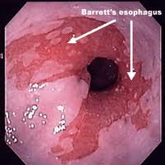
Barrett’s Esophagus
Metaplasia of the esophageal tissue
This is a precursor to esophageal adenocarcinoma

Slide 13
Infectious Esophagitis
Most common is Candida esophagitis
Other common causes include HSV and CMV
Most common in immunosuppression from organ transplantation or in HIV/AIDS patients
Not common in HIV/AIDS patients with CD4 counts >200, but common in patients with CD4 counts <100

Slide 14
Evaluation
Good H&P
Endoscopy with biopsy and brushing for diagnostic certainty
  Candida esophagitis is diffuse, linear, yellow – white plaques adherent to the mucosa
  CMV esophagitis is characterized by one to several large, shallow, superficial ulcerations
  Herpes esophagitis results in multiple small, deep ulcerations

Slide 15
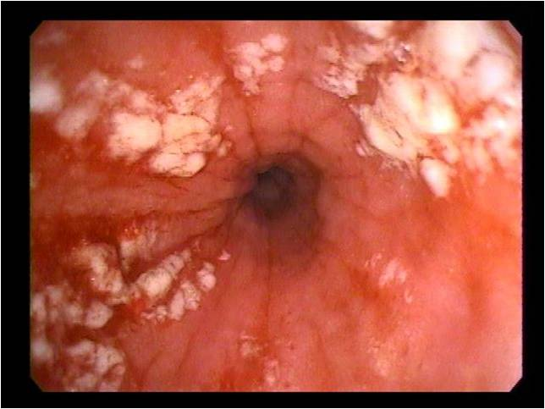
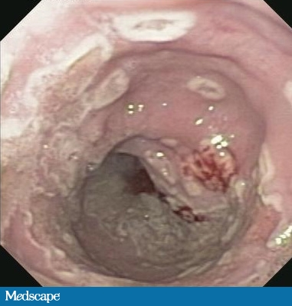
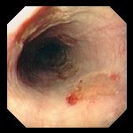

Slide 16
Signs and Symptoms
Difficult or painful swallowing
Heartburn
Retro sternal discomfort or pain
Nausea and vomiting
Fever and sepsis
Abdominal pain
Epigastric pain
Hematemesis
Anorexia weight loss
Cough

Slide 17
Treatment
Candida esophagitis
Fluconazole 100 mg/dL orally for 14 – 21 days.
If patient is not responding in 7 to 14 days, they should undergo endoscopy with brushing, biopsy, and culture to distinguish resistant fungal infection from other infections.
McPhee, S. J., & Papadakis, M. A. (2011). Infectious esophagitis. 2011 Current
medical diagnosis and treatment (pp 574 – 575). New York, NY: McGraw Hill

Slide 18
Treatment
Cytomegalovirus esophagitis
Patients with HIV, immune restoration with highly active antiretroviral therapy.
Ganciclovir 5 mg/kg IV every 12 hours for 3 to 6 weeks.
At the resolution of symptoms, oral valganciclovir, 900 mg once daily may be used to finish out the course of therapy.
McPhee, S. J., & Papadakis, M. A. (2011). Infectious esophagitis. 2011 Current
medical diagnosis and treatment (pp 574 – 575). New York, NY: McGraw Hill

Slide 19
Treatment
Herpetic esophagitis
Immunosuppressed patients may be treated with oral acyclovir, 400 mg orally five times a day.
Acyclovir 250 mg/m² IV every 8 – 12 hours for 7 to 10 days may also be used.
Nonresponders require therapy with foscarnet 40 mg/kg IV every eight hours for 21 days.
McPhee, S. J., & Papadakis, M. A. (2011). Infectious esophagitis. 2011 Current
medical diagnosis and treatment (pp 574 – 575). New York, NY: McGraw Hill

Slide 20
Medicated–Induced Esophagitis
Medications that cause direct esophageal mucosal injury.
  Tetracyclines (particularly doxycycline)
  Aspirin
  Potassium chloride
  Quinidine preparations
  Iron compounds

Slide 21
Esophageal pill retention
Lack of adequate liquids and long periods in the recumbent position
Ingestion of pills immediately prior to sleep
Age greater than 70 years and decreased peristaltic amplitudes
Patients with cardiac disease, particularly following thoracotomy’s

Slide 22
Clinical Presentation
Patients often present with sudden onset of odynophagia and retro sternal pain
Onset of symptoms may be related to swallowing a pill without water, commonly at bedtime
Diagnosis is usually made when a patient experiences the typical symptoms after improper ingestion of a pill known to cause esophageal injury

Slide 23
Treatment
Most cases of esophageal injury will heal without intervention within a few days
Taking medications with the proper amount of water
Liquid preparations if available
Discontinuing oral medications known to cause esophageal injury if possible
Castell,D.O. (2013) Medication – induced esophagitis. Uptodate. Retrieved from http://www.uptodate.com/contents/medication-induced-esophagitis

Slide 24
Eosinophilic Esophagitis
This is believed to be an allergic disorder induced antigen sensitization in susceptible individuals
Fairly uncommon but prevalence is rising due to increasing incidents and a growing awareness of the condition
Dellion E.S., Gonsalves, N., Hirano, I., et al. (2013). ACG clinical guideline: evidence-based approach to diagnosis and management of esophageal eosinophilia and eosinophilic esophagitis(EoE). American Journal of Gastroenterology, 108, 679-692. doi:10.1038/ajg.2013.71

Slide 25
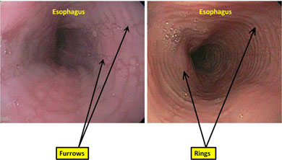
Endoscopy

Slide 26
Diagnostic Recommendations
The underlying cause needs to be identified
Is defined by symptoms, histology, and treatment response
The distal and proximal esophagus should be biopsied, as should the antrum and/or duodenum, and all adult patients with gastric or small intestinal symptoms or endoscopic abnormalities

Slide 27
Treatment Recommendations
Topical swallowed steroids for an initial eight week period is the first line treatment
Elimination of possible food triggers from the diet can be an initial treatment for pediatric and adult patients
Patient should be informed that once treatment has stopped, there is a high risk that eosinophilic esophagitis will recur

Slide 28
Radiation/chemoradiation esophagitis
Head, neck, and thoracic cancers are associated
Increased risk factors include increase radiation dose and concurrent chemotherapy
Treatment regimen may include viscous lidocaine, PPI’s, promotes motility agents, a bland diet, avoidance of alcohol, coffee, and acidic foods
Berkeley, F. J. (2010). Managing the adverse effects of radiation therapy.
American family physician website. Retrieved from www.aafp.org/afp

Slide 29
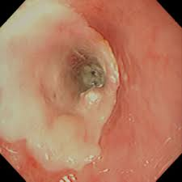
Endoscopy

Slide 30
Question?
A 42-year-old gentleman presents to the emergency department with intermittent chest pain that he describes as a burning sensation in the epigastric area. The patient has no previous medical history. After a negative cardiopulmonary work up, the best choice of treatment for this patient’s pain is ?
  a. Vicodin 1 to 2 tablets PO every 4 to 6 hours PRN
  b. Ranexa 500 mg PO twice a day
  c. Omeprazole 20 mg PO once daily
  d. Cimetidine 400 mg twice a day

Slide 31
A 42-year-old gentleman presents to the emergency department with intermittent chest pain that he describes as a burning sensation in the epigastric area. The patient has no previous medical history. After a negative cardiopulmonary work up, the best choice of treatment for this patient’s pain?
  a. Vicodin 1 to 2 tablets PO every 4 to 6 hours PRN
  b. Ranexa 500 mg PO twice a day
  c. Omeprazole 20 mg PO once daily
  d. Cimetidine 400 mg twice a day
McPhee, S. J., & Papadakis, M. A. (2011). Gastroesophageal reflux disease. 2011 Current
medical diagnosis and treatment (pp 569 – 573). New York, NY: McGraw Hill

